Slide 1
Big Data Week 12 Unsupervised learning and Text Mining
Professor Arturo Castellanos, PhD
Assistant Professor – William & Mary
Big Data - MSBA

Slide 2

Supervised learning: Prediction
Goal: Predict numerical target (outcome) variable
Examples: sales, revenue, performance
As in classification:
Each row is a case (customer, tax return, applicant)
Each column is a variable
Taken together, classification and prediction constitute “predictive analytics”

Slide 3


Model Building + Parameter optimization
Problem: what family of models work better with this data?
Solution: model building + parameter optimization

Slide 4
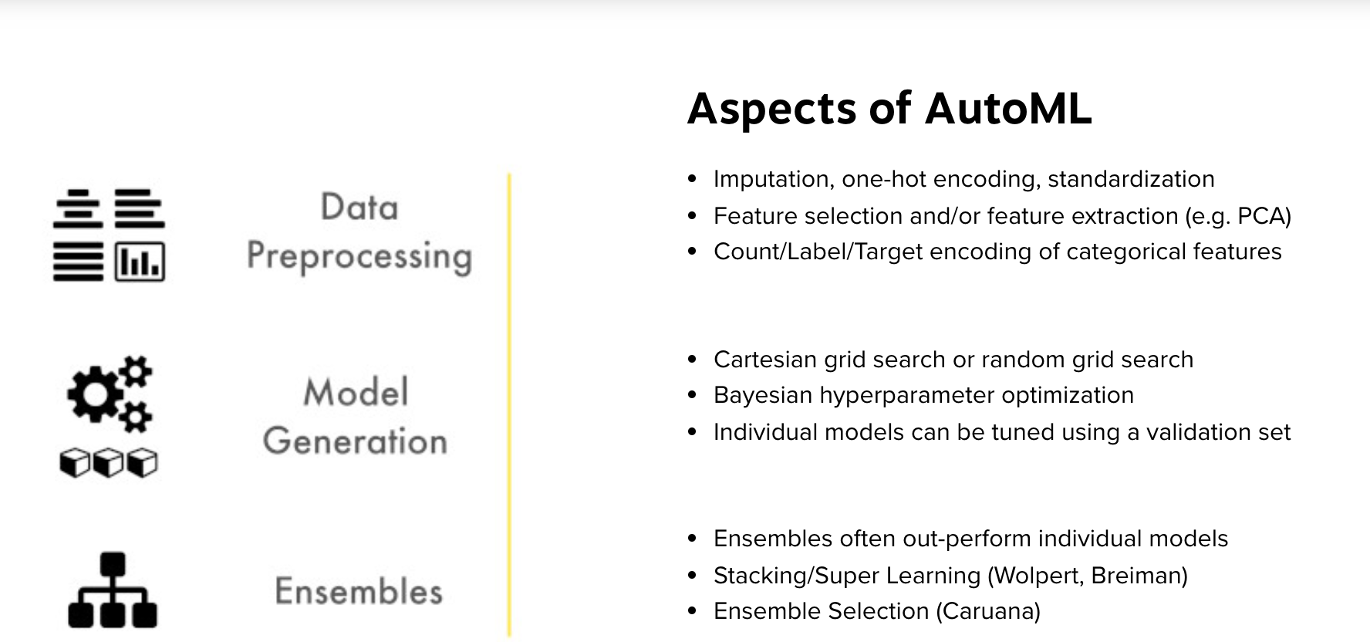
AutoML
Source: https://www.h2o.ai/products/h2o-automl/
https://automl.github.io/auto-sklearn/master/

Slide 5
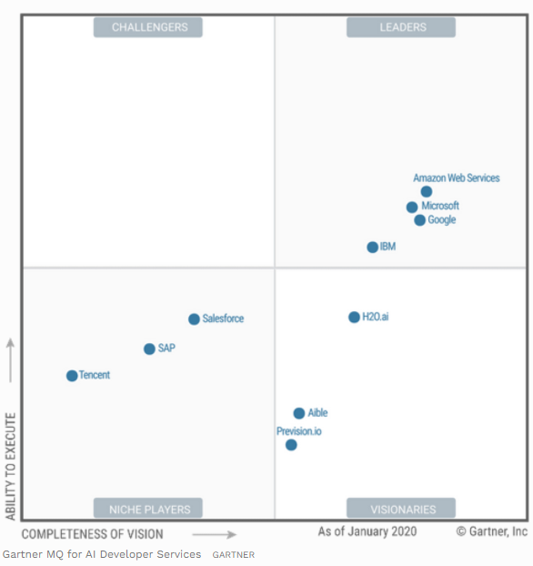
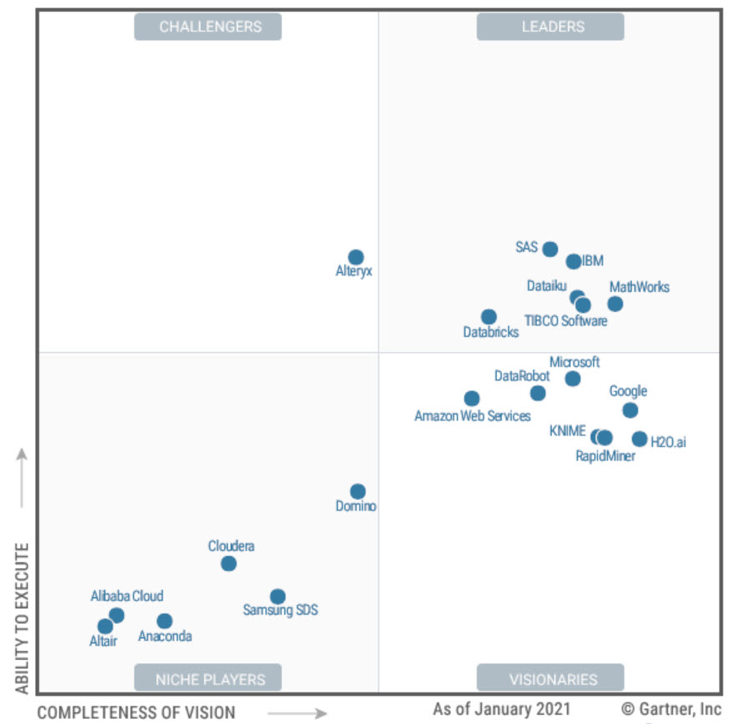
DEMO
H2O Flow
H2O Driverless AI
Data Science and Machine Learning Platforms
AI Services
Source: https://www.forbes.com/sites/janakirammsv/2020/03/02/key-takeaways-from-the-gartner-magic-quadrant-for-ai-developer-services/?sh=7edb9451e3e5

Slide 6
Unsupervised Learning
Learning useful structure without labeled classes, optimization criterion, feedback signal, or any other information beyond the raw data
inputs
grouping
cluster 1
Segmentation /Clustering/Profiling
Group customers into distinct segments
Summarization/Rules
Purchases of related products
cluster 2
cluster 3
cluster 1
cluster 2
Unsupervised classification: grouping of cases based on similarities in input values

Slide 7
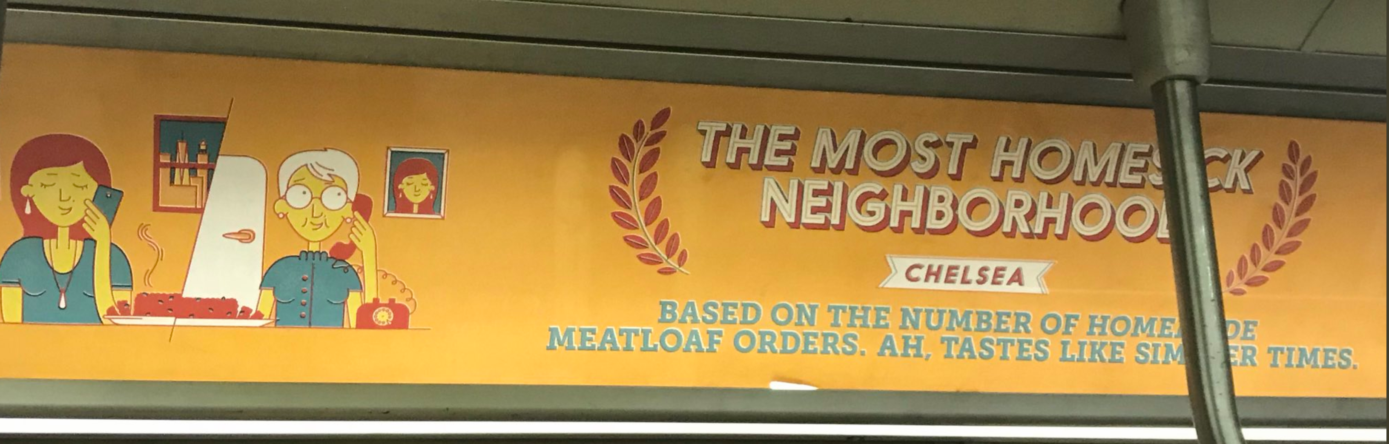

Customer Segmentation

Slide 8
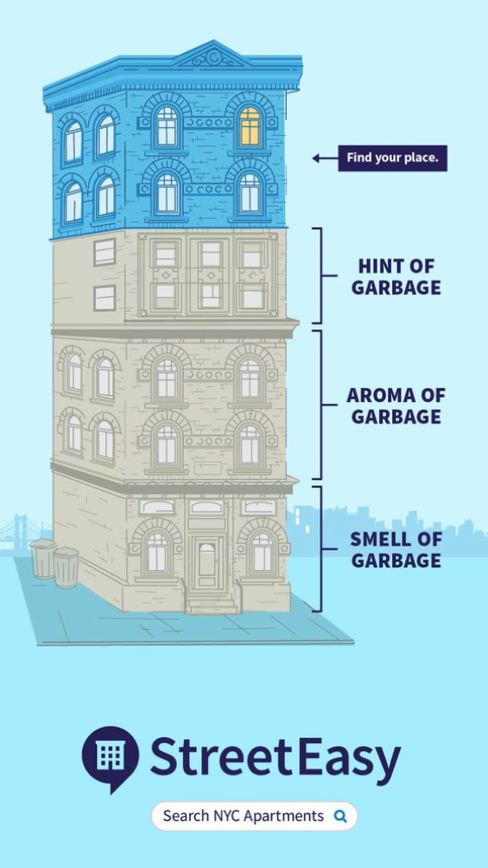
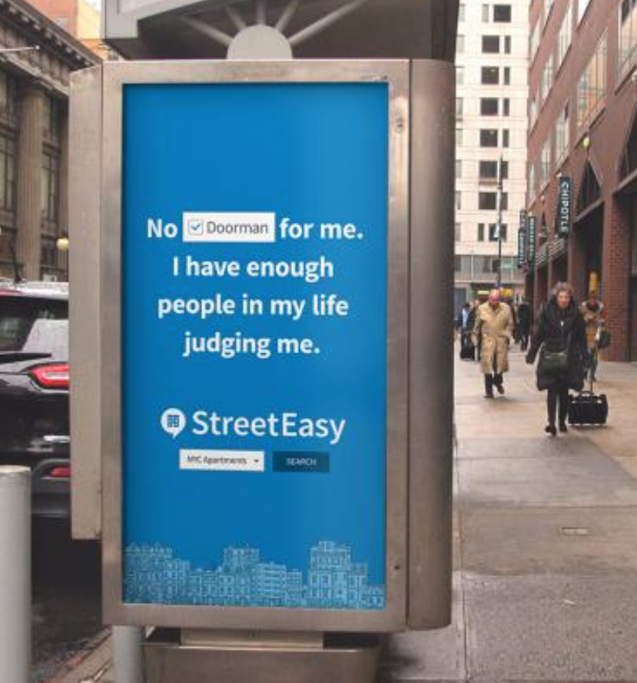
“Find your place campaign”

Slide 9
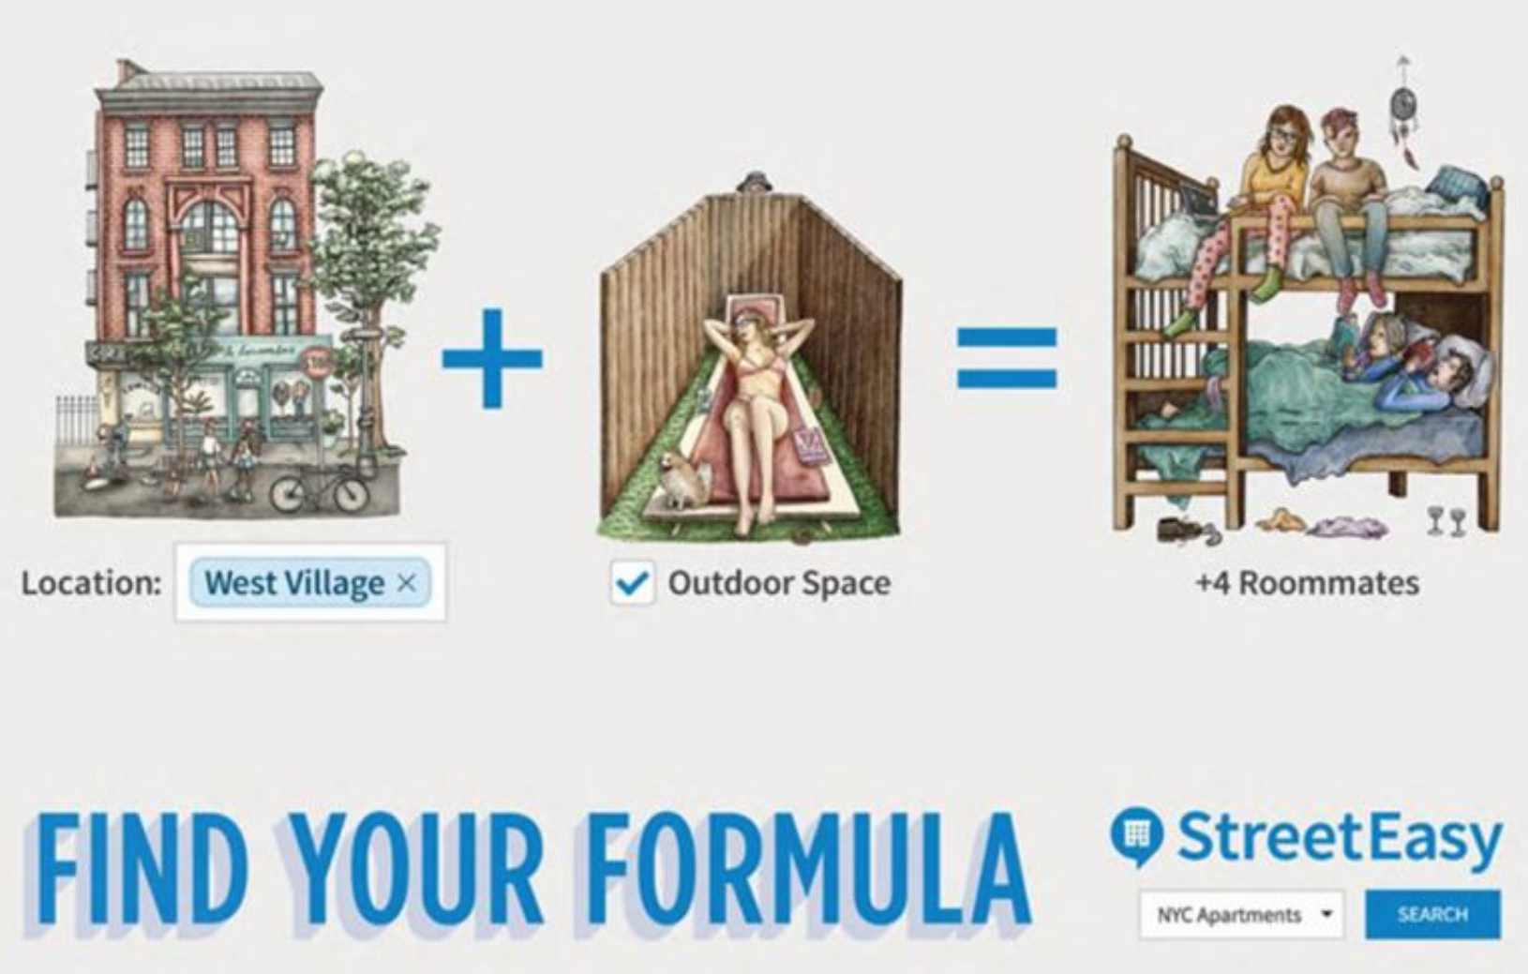
“Find your formula campaign”

Slide 10
K-means algorithm
1. Select inputs.
2. Select k cluster centers.
3. Assign cases to closest center.
4. Update cluster centers.
5. Re-assign cases.
6. Repeat steps 4 and 5
until convergence.

Slide 11
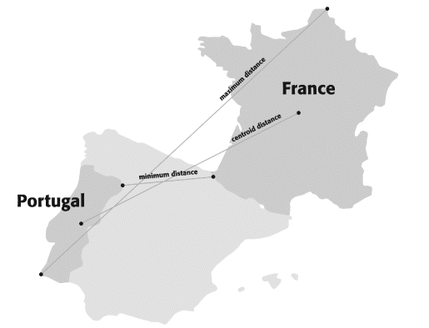
Measuring distance between two clusters
Two distance measures:
Distance between data points (measured by the euclidean distance of normalized scores for numerical variables).
Distance between clusters
Min
Max
Centroid
Source: Chapter 15 (Textbook: Schmueli, Bruce, and Patel 2016 ‘Data Mining for Business Analytics’)

Slide 12
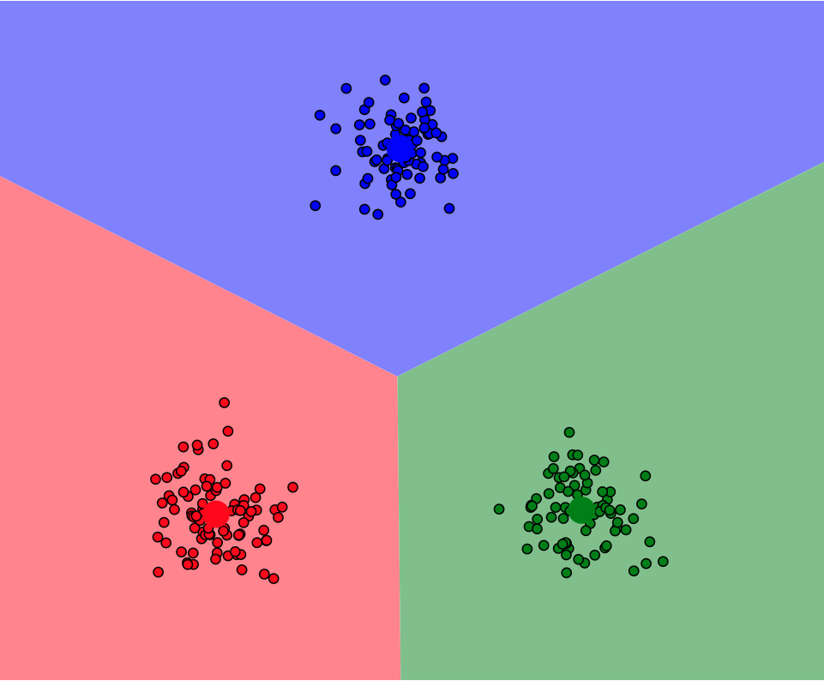
Interactive demo:
Link

Slide 13
Text Mining
Is the process of discovering and extracting meaningful patterns and relationships from text collections
Pattern discovery: topics, themes, and concepts
Predictive modeling: you can use these concepts, themes, and concepts to predict an outcome (e.g., spam/not spam, review is good or bad, sentiment is positive or negative).

Slide 14
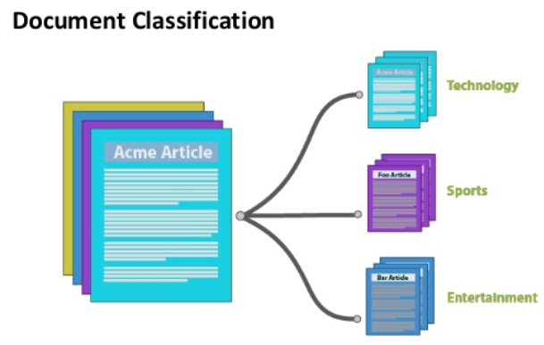
Source: KdNuggets

Slide 15
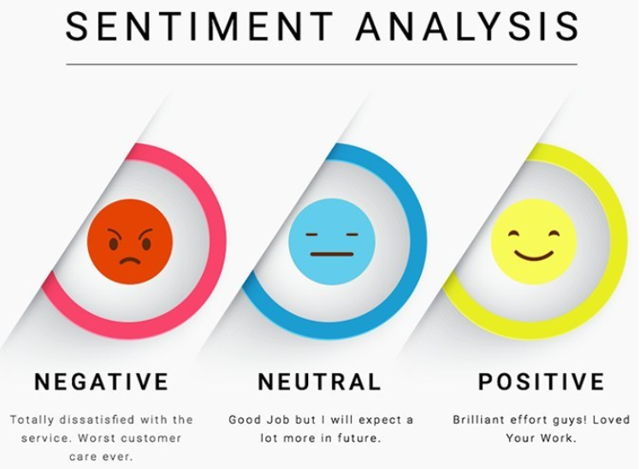
Source: KdNuggets

Slide 16
Select Data Source
Single Text File
Each record contains a different “instance”
Folders containing multiple text files of a particular type
Loads multiple folders
RSS Feeds and URL
Documents (.doc, .pdf, .xml)

Slide 17
Text Normalization
Case
Make all lower case
Clean up transcription and typing errors
Do n’t, movei, etc.
Correct misspelled words
Phonetically
Use fuzzy matching algorithms
Dictionaries
Use POS and context to make good guess

Slide 18
Tokenization
Convert streams of characters into “words”
Main clues: white space.
Words can contain special characters, such as these: . , ‘ – etc.
Examples: Dr. O’Malley 555-1212
I love Text Mining!

Slide 19
Stemming
Unifies Variations of the same idea generally by reducing words to their most basic element.
Big, Bigger, Biggest -> “Big”
Apply, Applications, reapplied -> “apply”

Slide 20
Stop Words
Common words that add little or no value
Taking them out reduces dimensionality
Examples: a, an, and, as, at, be, but, by, for, if, in, into, is, it, no, not, of, on, or, such, that, the, their, then, there, these, they, this, to, was, will, with.

Slide 21
Multi-Word Features: N-grams
N-Grams
Combinations of characters or words
“N” means how many characters or words
2-grams: “vice president”
3-grams: “central intelligence agency”
Allows gaps between words

Slide 22
Feature engineering
Word embeddings
Creating topic vectors (unsupervised) –LDA analysis
Pre-trained models (BERT, ELMo)

Slide 23
Text Mining Features
Keywords
Keyword Flags: Bag of Words
TF (Term Frequency) Count of keywords in field
Binned Counts (doesn’t exist, exists once, exists more than once)
IDF
IDF: Inverse Document Frequency
=log(1+Number of Docs/Number of Docs with Term)
Multiple-word phrases: n-grams
Reduced dimensionality features: PCA
Word embeddings

Slide 24

Word embeddings
Word2vec and Glove word embeddings are context independent- these models output just one vector (embedding) for each word, combining all the different senses of the word into one vector.

Slide 25
Text mining demo – Python Yelp Reviews classifier

